Slide 1

Nashville Businesses in Black Communities
Taryn Patterson
Data Analyst
Nashville Software School

Slide 2
Motivation
“Americans filed paperwork to start 4.3 million businesses last year, according to data from the Census Bureau, a 24 percent increase from the year before and by far the most in the decade and a half that the government has kept track. Applications are on a pace to be even higher this year.” – New York Times (https://www.nytimes.com/2021/08/19/business/startup-business-creation-pandemic.html)
In 2020, there were 12,753 new business applications submitted in Davidson County, up 18.48% from 2019. (https://www.census.gov/econ/bfs/index.html)
Black-owned businesses make up 7.9% of all businesses in Davidson County (https://overheardonconferencecalls.com/business/best-cities-for-black-owned-businesses/
Notes:
According to the New York Times, covid times have seen an increase in entrepreneurship and people going into business for themselves. This has largely been due to

Slide 3
The Data
Data Sources
Tools used
Census Data: Census Reporter. This website pulls census data from the 2019 5-year American Community Survey
Business Data: Google Places API (code heavily adopted from Nashville Food Deserts).
Excel
Python
Tableau

Slide 4
Summary of Gathering and Analysis of Data
Created a Percentage of Total Population column in the census data geojson file and filtered the dataframe to only include census tracts in Davidson County with a Black population of 50% or more.
Obtained the length of the perimeter and centroid of each tract’s polygon and used that to get an approximate radius. I added a half mile buffer to this radius to make sure nothing got left out.
Narrowed down the types of businesses I was looking for to a few key types. Those were “gas station”, “supermarket”, “hospital”, “clothing store”, “restaurant”, “bar”, and “store”.
Used the centroid and radius for each tract and ran these through the Google Places API to get businesses of the aforementioned types, created a dataframe with the info and got rid of any duplicates.
Performed a spatial join between the Census dataframe and the businesses dataframe to get only businesses within the tracks with a predominantly black population.

Slide 5
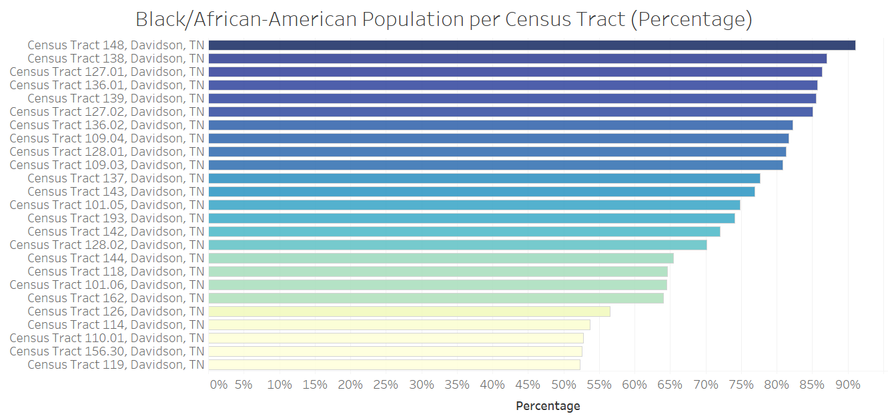

Slide 6
